Slide 1

ELID Product Technical Training
EL2306D & WinPro
SESSION 2
ADILAH
ELID DPD

Slide 2

Training Outline (Session 1 – Aug 12)
Introduction of EL2306D
EL2306D wiring
Quick start command of EL2306D
Introduction of WinPro
SQL 2008 R2 installation
WinPro installation
Communication connection
Quick start function of WinPro
Support documents
Q&A

Slide 3
Training Outline (Session 2 – Sept 2)
Refreshment from session 1
Full standard command of EL2306D
Full standard function of WinPro
Support documents
Q&A

Slide 4
Training Outline (Session 3 – Sept 30)
Refreshment from session 1 & 2
EL2306D + WinPro new features
WinPro advanced features
Support documents
Q&A

Slide 5

Refreshment from 1st Class
EL2306 VS EL2306D
EL2306D Specification
Hardware Board
EL2306D Configuration
EL2306D Wiring – Power, Keypad & Reader, Door, EA8, RS485, Multidrop, TCP/IP
Connection Serial & TCP/IP – Single bus & Multibuses

Slide 6
Refreshment from 1st Class
EL2306D Quick Start Setting – Cold Start, Set Date/Time, Holiday, Timer, Timezone, Add/delete card, Card+Pin, Pin entry, Communication
Type of Cards and Card Format
SQL 2008 R2 Installation
WinPro – PC requirement, License, Installation
LAN Module Setting
WinPro Quick Start – Communication, Configure license, Add controller, Timer, Timezone, Accessibility, Send Parameter, Add/delete Card, Pulse Door Open, Enable Card+Pin, Enable Pin Entry, Report

Slide 7
EL2306D Command Setting
  Permanent Lock Release
  Inhibit Access
  Antipassback
  Lock Release Time & Shunt Activation
  Auto Lock Release Timezone
  Auto Pin Disable Timezone
  Dual Card
  Special Card
  Interlocking
  I/O
  Miscellanous command

Slide 8

PERMANENT LOCK RELEASE
  Permanent lock release is for keeping the door open
  Applicable for any event that require door to open along the event
  To set permanent lock release
User Menu > Door Menu > Para menu> P.L Rel
Set to ON

Slide 9
INHIBIT ACCESS
  Inhibit access is to block all valid card from access the door
  Useful in certain situations such as in case of a theft/murder, where a department or whole floor can be locked down for investigation.
  To set Inhibit Access
User Menu > Door Menu > Para menu> Inh Acc
Set to ON

Slide 10
ANTIPASSBACK
  Once turned on Anti-passback, you will need to badge out before badging in again
  Applicable to carpark, attendance enforcement, staff movement analysis
Anti-Passback has 4 options:-
OFF
TMR (Timer)
2RDR (2-Reader) – single door
4RDR (4-Reader) – between 2 doors

Slide 11

ANTI-PASSBACK
  To set Anti-passback Timer
  Then, enable anti-passback
  For Anti-passback by reader just do Step 2 and set to 2-RDR or 4-RDR
Step 1: User Menu > Door Menu > APB Time
Step 2: User Menu > Door Menu > Para menu> Anti PB
Set to TMR

Slide 12
Permanent Lock Release, Inhibit Access and Anti-passback DEMO

Slide 13

LOCK RELEASE TIME
  This command is used for setting how many seconds the lock should remain released after a valid card is read.
  To set lock release time
  The default release time is 005 seconds for both door 1 and door 2. You can change the release time to any other values from 001 to 200 seconds.
Eng Menu > Door Menu > Lr. Time

Slide 14
SHUNT ACTIVATION
  This command is used to set time for triggering door shunt output. Each time the door is validly open, the door shunt output is activated.
  The duration of activation may be set as a multiple of the Lock Release time. The multiplication factor can be x1, x2, x4, x8.
  For example,
  5 seconds (Lock Release Time) x 2 (Shunt Activation Time) = 10 Seconds
  Then, the Door Shunt Output will be activated for 10 seconds each time a valid door entry occurs
  Applicable for triggering Door Left Open alarm. Door Left Open alarm will be activated after 10 seconds each time door left open.

Slide 15
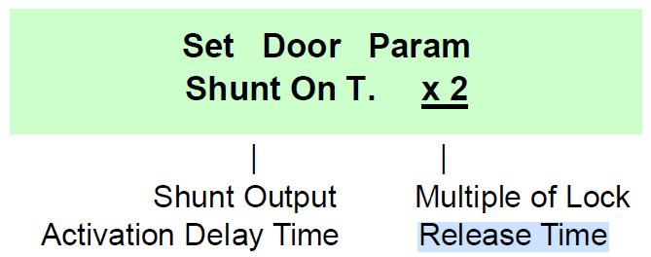
SHUNT ACTIVATION
  To set shunt activation
  The multiplication factor can be x1, x2, x4, x8.
Eng Menu > Door Menu > Lr. Time

Slide 16
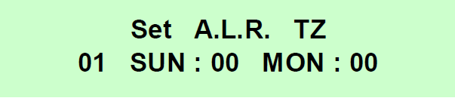
AUTO LOCK RELEASE TZ
  This command is useful if the traffic is too high, and security is needed only after office hour, then, use Auto Lock Release Time Zone which it will permanently release the door on certain period.
  For example, you can set 9am to 5pm except lunch hour, to unlock the EM-Lock, allow free flow without card badging.
  To set auto losk release timezone
User Menu > Door Menu > ALR TZ
Door #
Timer
Timer

Slide 17

PIN DISABLE TZ
  This command is to allow user bypass pin mode and only use card within the period set. Out of the period it will turn to card+pin mode.
  For example, during working hour 9am to 5pm only card badging is required to open the door, and after working hour user require to use card+pin.
  To set pin disable tz
User Menu > Door Menu > APIN TZ
Door #
Timer
Timer

Slide 18
LRT, Shunt Activation, ALR TZ and Pin Disable TZ DEMO

Slide 19
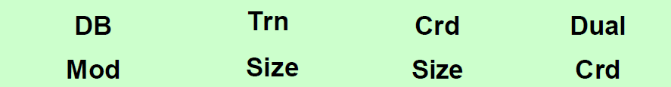
DUAL CARD
  This command is to give higher security where the door will unlock when 2 valid cards badging on the reader. In other words, it requires 2 persons to be present in order to open the door.
  Applicable to high security area like server room, account room and etc.
  To set dual card mode
Eng Menu > Card Menu > Dual Card
OFF/ON

Slide 20
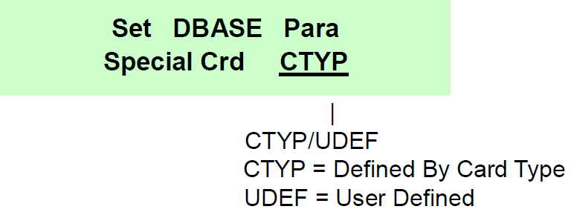
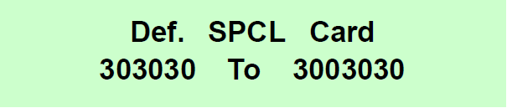
SPECIAL CARD
  This special card is for arm/disarm the sensor and manually ON/OFF the output.
  There are 2 types:
  CTYP: Defined by Card Type. Whether the card is recognize as special card or normal user card depends on how the card is encoded.
  UDEF: User Defined. You required to type in the range Card ID numbers that the controller will recognize as special card
  To set special card
Eng Menu > Card Menu > Spl Crd
If “UDEF” is selected, then the screen will show

Slide 21


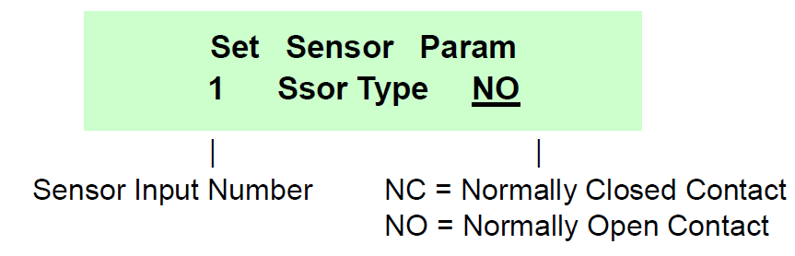
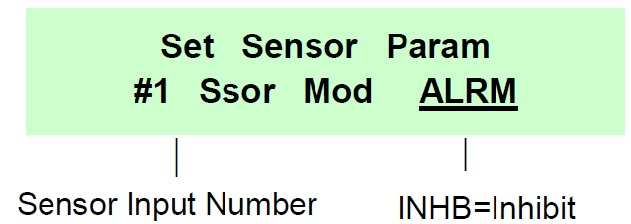
INTERLOCKING
  This command is used to interlock reader operation between 2 doors. In other words, you wish to disable the Reader operation when another door opens
  To set interlock
Then,
Eng Menu > Sensor Menu > Sensor Type
Eng Menu > Sensor Menu > Operation Mode
Enter the sensor for door number
Enter the sensor for door number
Select sensor type
Select sensor operation

Slide 22
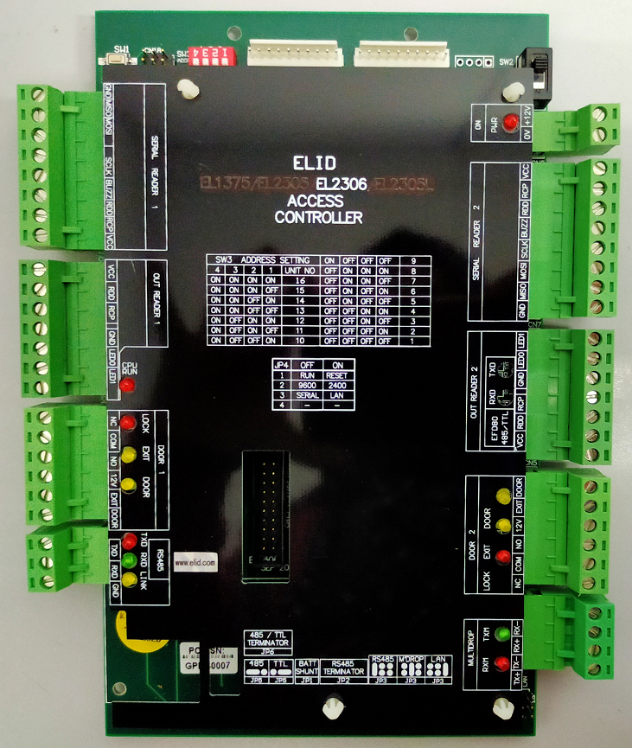
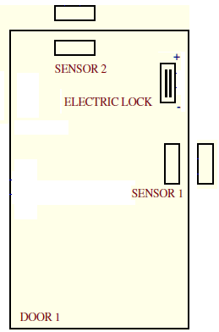
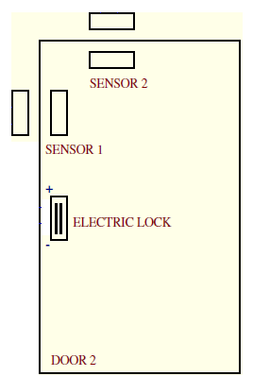
INTERLOCK WIRING
9
8
9
8
NC
GND
COM
DOOR
12V
12V
DOOR
COM
NC
GND

Slide 23
Dual Card, Special Card and Interlock DEMO

Slide 24
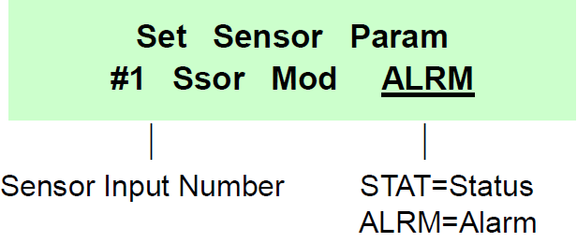
I/O (Sensor Input)
  For sensor input, there are 2 modes which are:
  ALARM (require arm/disarm to activate the system)
  STATUS (system activate according to sensor status)
Eng Menu > Sensor Menu > Operation Mode
Enter the sensor for door number
Select sensor operation

Slide 25
I/O (Output type)
  For output, there are 2 types which are:
  GP (output can be activated manually by means of a special card, or from a PC or by a timer)
  EVENT (output is activated by an input event)
  If during the initial SET-UP, you have set the unit to EL2000 OUTPUT EMULATION mode, then only outputs 5 & 6 can be set, the other 4 outputs are predefined as Duress Alarm Output, Door Open Alarm Output, Door Shunt Output and Sensor Alarm Output
  If during the initial SET-UP, you have not set the unit to EL2000 OUTPUT EMULATION mode, then, all the 6 outputs can be set.

Slide 26

I/O (Output mode)
  If you have selected "GP" mode, the setting is complete, however, if you have selected any of the point to "EVNT" mode, the display will now show: -
  There are 4 modes available
Eng Menu > Output Menu > Output Type
SHRT (Short) | Each event, defined by the command "OUTPUT EVENT" will cause the output to turn on for duration of 1 second.
TOG (Toggle) | Each occurrence of an event will cause the output to toggle ON.OFF.ON.OFF etc.
MULT (Multiple) | Each event will cause the output to send a succession of pulses, each of 1-second duration in succession. The number of pulses is programmable.
PULSE | Each event will cause the output to turn on for a time defined by the command "OUTPUT DURATION".

Slide 27
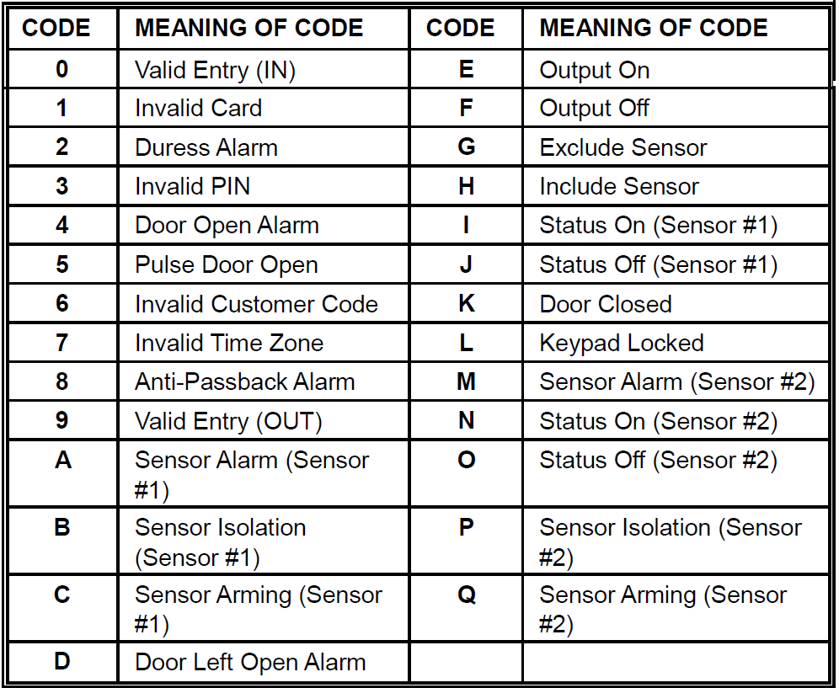

I/O (Output event)
Table Of Transaction Code
  This command allows you to define what type of activity occurring at the door will trigger a specific output.
Eng Menu > Output Menu > Output Event

Slide 28

I/O (Output duration)
  The "OUTPUT DURATION" command is to set the duration for which the output point is to stay activated
Eng Menu > Output Menu > Output Duration

Slide 29
Input and Output DEMO

Slide 30



Miscellaneous Command
  Door sensor – to select the type of Door-Contact you wish to use
  Push Button – to enable/disable push button function
  Valid Buzzer - to enable/disable the buzzer sound for every valid card entry
Eng Menu > Door Menu > Door Sensor
Eng Menu > Door Menu > Push Exit
Eng Menu > Door Menu > Valid Buzer

Slide 31
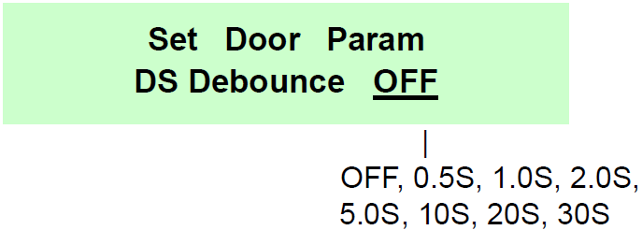

Miscellaneous Command
  Door sensor debounce – applicable for glass door
  Transaction Size - to extend the transaction buffer
Eng Menu > Door Menu > Door Sensor Debounce
Eng Menu > Card Menu > Trans Size
Normal: 1021 transactions per door
Extended: 5108 transactions per door

Slide 32
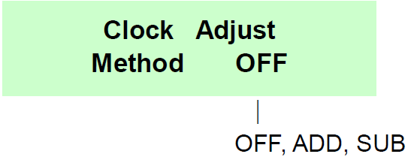
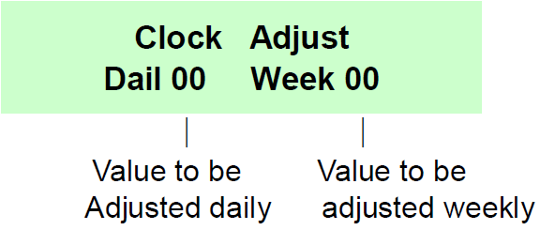
Miscellaneous Command
  Adjust Clock - This command allows the user to calibrate the accuracy of EL2306D calendar clock. It allows the user to add or subtract up to 60 seconds daily or weekly.
User Menu > Time Menu > Adj Clock
If METHOD is set to ADD or SUB, the next following next screen appears:

Slide 33
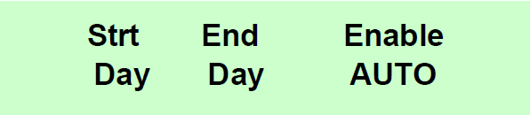
Miscellaneous Command
  Daylight Saving- This command allow controller automatically adjust time one hour forward according to the day light saving start date and adjusted one hour backward according to the day light saving end date.
  Enter the start date and end date, then set ‘Enable Auto’ to “Yes’ in order to activate the day light saving function.
User Menu > Time Menu > Day Light

Slide 34
Miscellaneous DEMO

Slide 35
WinPro Command Setting
  Add/delete floor plan and map
  Low level setting
  Communication multibuses
  Conditional I/O
  I/O
  Verify & Rectify
  Add/delete card by batch
  Auto Lock Release TZ
  Auto Pin Disable Timezone
  Lock Release Time

Slide 36
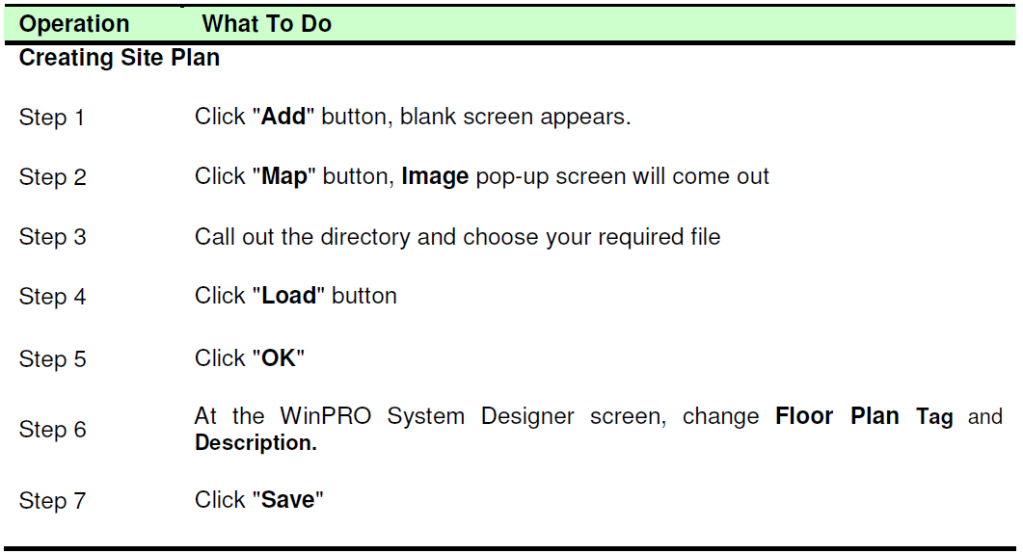
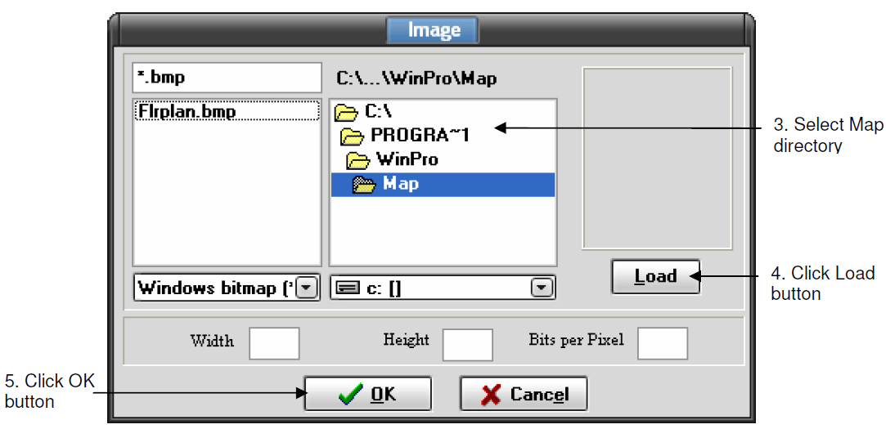
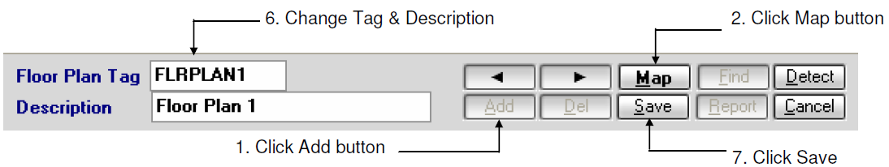
Add/delete floor plan and map

Slide 37
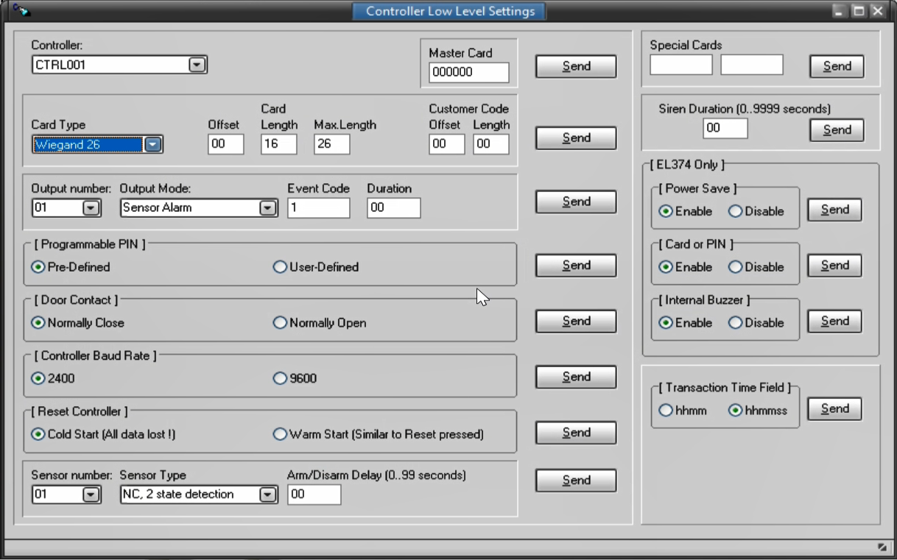
Low level setting
Edit WinPro\Edotpro.ini &
WinPro\Server\Edotpro.ini, set:
  [Options]
  LowLevelSettings=1
  Select <Setup> | <Low Level Settings

Slide 38
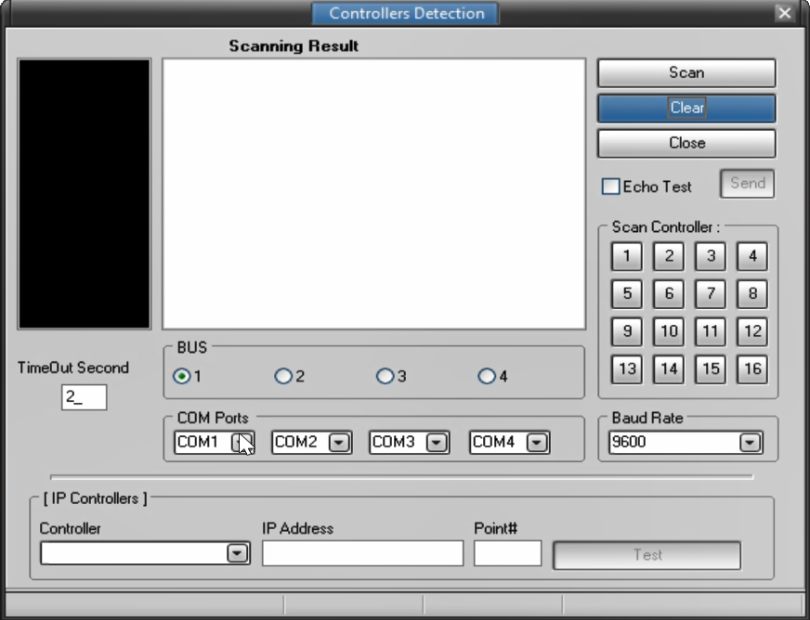
Communication Multibuses
Edit WinPro\Edotpro.ini &
WinPro\Server\Edotpro.ini, set:
  [Comm Setting]
  MultiCommSupport=1

Slide 39
Add/delete floor plan and map, low level setting, comm multi-buses DEMO

Slide 40
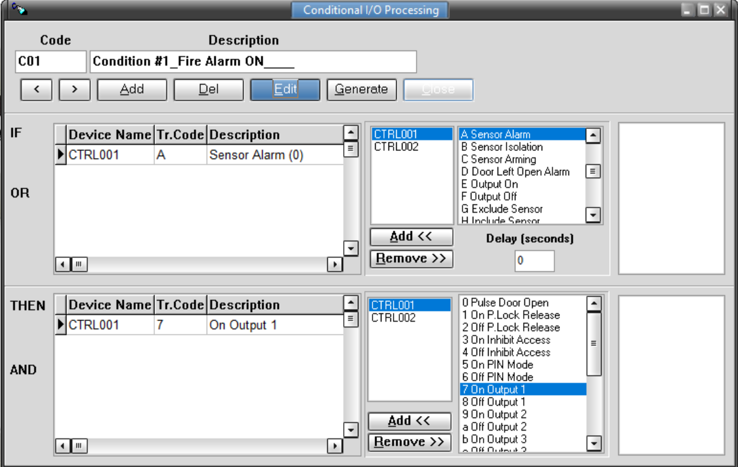
Conditional I/O
Edit WinPro\Edotpro.ini &
WinPro\Server\Edotpro.ini, set:
  [Options]
  CondIOEnabled=1

Slide 41
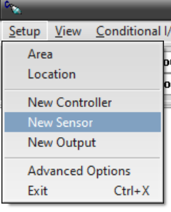
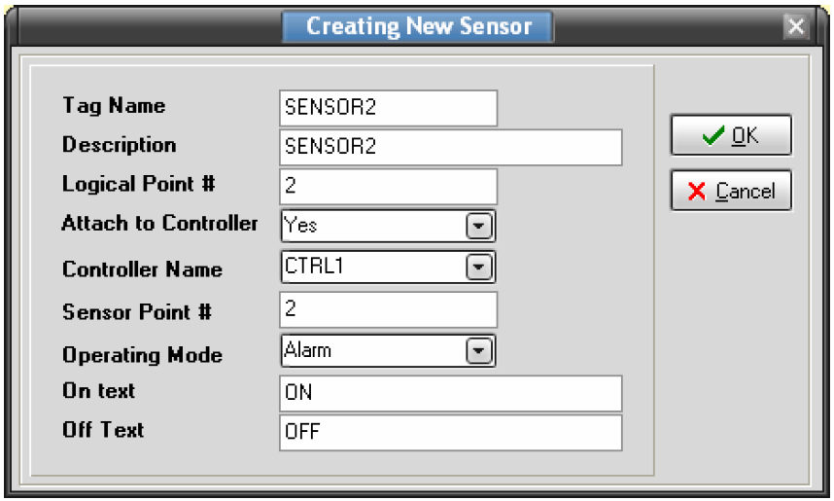
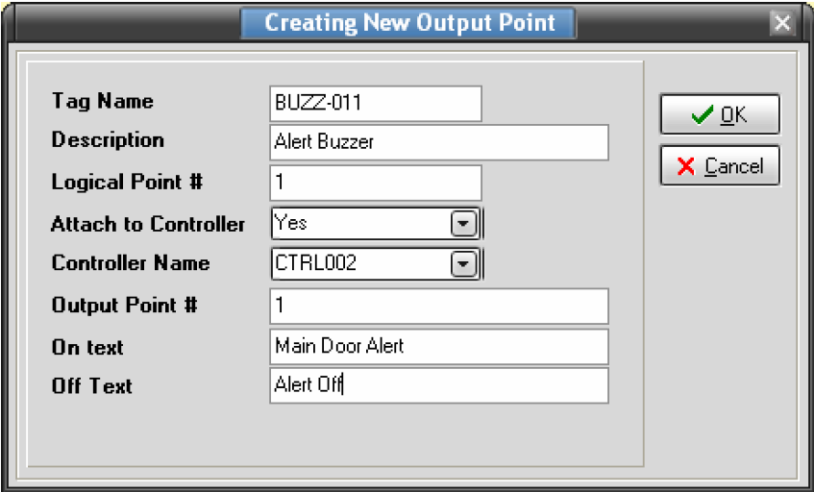
I/O
  To add sensor and output
WinPro Designer > Setup > New Sensor/Output
Over here you are required to define Attach To Controller which tells the system if this particular sensor is attach to any controller. If ‘YES’ then define the reader name or else leave both this section blank. The Operating Mode could either be ‘Alarm’ or ‘Status’. On Text will displays whatever you have keyed in, on the Status Bar. Off Text will not display it on the screen.
Key in the Tag Name as ‘BUZZ011’. Key in the description as ‘ALERT BUZZER’. The Logical Point # is the physical address of the reader. Attach To Reader should be ‘YES’ and the Reader Name as ‘CTRL002’. The Output Point # identifies the output point number in the reader, either Point ‘01’ or Point ‘02’. In this case, it should be Point ‘01’

Slide 42
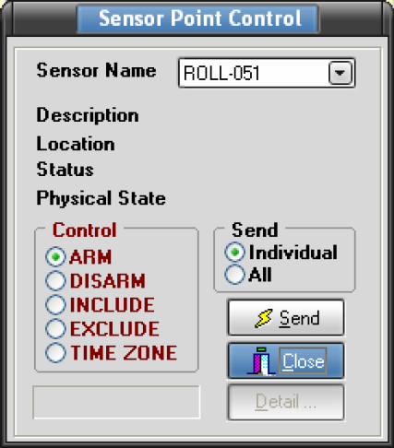
Sensor Input Control
  To control sensor
WinPro Manager > Control > Sensor
ARM meaning to activate a Sensor Point, and DISARM meaning to deactivate the Point.
INCLUDE meaning to select a sensor point. This applies to both Alarm and Status point. EXCLUDE is to deselect the sensor point. This means permanently deactivate a sensor point until INCLUDE is being set.
The Time Zone command here is used if a sensor point is defined as an alarm point. Then this point can be automatically disarmed during the time frame that the time zone is active and armed during the period that the time zone is inactive.

Slide 43
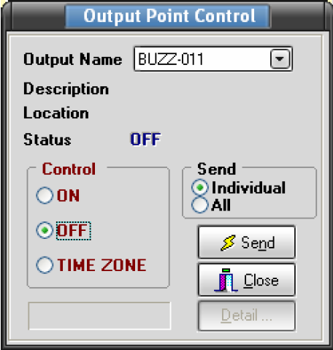
Output Control
  To control output
WinPro Manager > Control > Output
Choose an Output point that you wish to control. Select the control action as either ON or OFF. If you are sending down output time zone, select TIME ZONE option. In the Send selection panel, you can either select sending to “Individual” output point or “All” output point. Finally, click the “Send” button to execute the command.

Slide 44
Conditional I/O and I/O DEMO

Slide 45
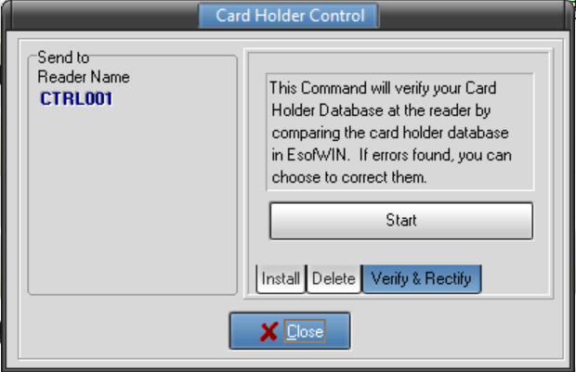
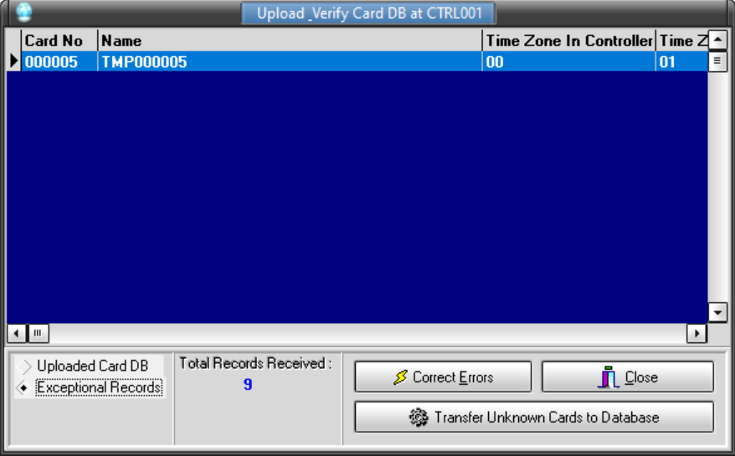
Verify and Rectify
  To check the differences between cardholder ID stored in the reader and database
Double click on the reader > Reader Option > Card DB Control > Card Holder Control

Slide 46
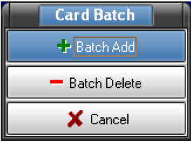
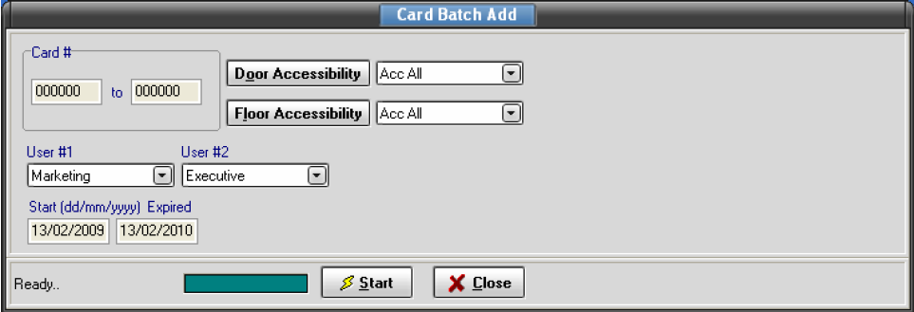
Add/delete card by batch
This command which allows you to add card holders in batches
WinPro Manager > Database > Card Holder > Batch
For example, if you wish to create the records for a group of 10 production workers. You can do so by keying the starting number and ending number on the Card # text boxes. Then maintain the Department and Position. Those fields that vary like the Name field ought to be keyed in separately. After editing, click the “Start” button to add the cardholders to database
The same procedure applies for deleting a batch of cardholders

Slide 47
Verify & Rectify, Add/delete by batch, ALR TZ, APD TZ and LRT DEMO

Slide 48
SUPPORT DOCUMENT
ELID WEBSITE
www.elid.com
ELID YOUTUBE CHANNEL
www.youtube.com
Search: ELID EL2306D or WinPro

Slide 49
Q & A Session

