Slide 1

ELID Product Technical Training
EL2306D & WinPro Advanced New features
SESSION 3
ADILAH
ELID DPD

Slide 2

Training Outline (Session 1 – Aug 12)
Introduction of EL2306D
EL2306D wiring
Quick start command of EL2306D
Introduction of WinPro
SQL 2008 R2 installation
WinPro installation
Communication connection
Quick start function of WinPro
Support documents
Q&A

Slide 3
Training Outline (Session 2 – Sept 2)
Refreshment from session 1
Full standard command of EL2306D
Full standard function of WinPro
Support documents
Q&A

Slide 4
Training Outline (Session 3 – Sept 30)
Refreshment from session 1 & 2
EL2306D Firmware Upgrade
EL2306D + WinPro new features
WinPro advanced features
Support documents
Q&A

Slide 5

Refreshment from 1st Class
EL2306 VS EL2306D
EL2306D Specification
Hardware Board
EL2306D Configuration
EL2306D Wiring – Power, Keypad & Reader, Door, EA8, RS485, Multidrop, TCP/IP
Connection Serial & TCP/IP – Single bus & Multibuses

Slide 6
Refreshment from 1st Class
EL2306D Quick Start Setting – Cold Start, Set Date/Time, Holiday, Timer, Timezone, Add/delete card, Card+Pin, Pin entry, Communication
Type of Cards and Card Format
SQL 2008 R2 Installation
WinPro – PC requirement, License, Installation
LAN Module Setting
WinPro Quick Start – Communication, Configure license, Add controller, Timer, Timezone, Accessibility, Send Parameter, Add/delete Card, Pulse Door Open, Enable Card+Pin, Enable Pin Entry, Report

Slide 7
Refreshment from 2nd Class
EL2306D Full Command Setting - Permanent Lock Release, Inhibit Access, Anti-passback, Lock Release Time, Shunt Activation, Auto-Lock Release TZ, Auto-Pin Disable TZ, Dual Card, Special Card, Interlocking, I/O, Miscellaneous Command.
WinPro Full Command Setting – Add/delete Floor Plan and Map, Low Level Setting, Communication Multibuses, Conditional I/O, I/O, Auto-Lock Release TZ, Auto-Pin Disable TZ, Lock Release Time, Verify & Rectify, Add/delete Card by batch

Slide 8
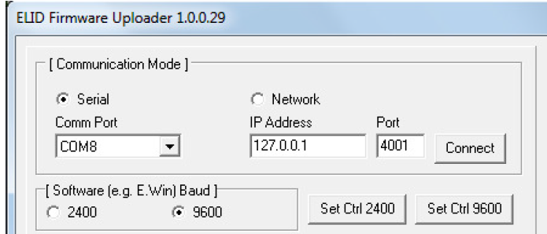
EL2306D Firmware Upgrade
  The new Downloader v10029 will work with controller for firmware version 1241 or newer
  If firmware is older than 1241, you should use Multi-link to upgrade.
  Downloader can work with LAN, RS485 or Multidrop
  How to use Downloader?
Execute the Downloader program (For Window 7 and 10, you must run as administrator else it would not detect the Comm Port)
Enter a password. The default password is “wonderful world”.
Set communication mode. If serial tick the “Serial” box. Select the corresponding Comm Port. If LAN tick “Network” box and set IP Address and port number
Set baud rate. Set the baud rate to that which E.Win is running. Usually, if the connection is by multidrop, the baud rate will be 2400. If the connection is by RS485, the baud rate will be 9600. If LAN is selected, the baud rate setting is ignored.

Slide 9
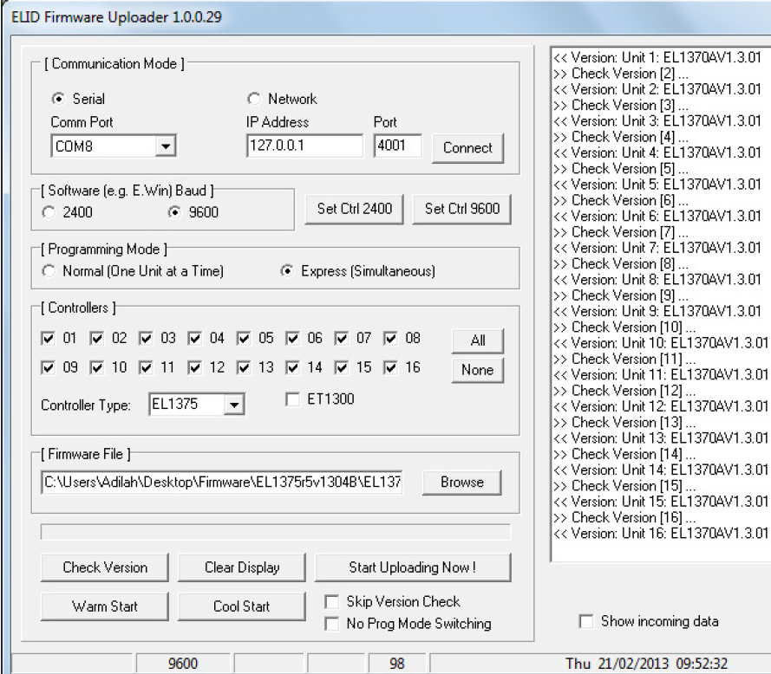
Set programming mode to “Normal”
Set unit no and controller selection is “EL2305”
Click the “Browse” button and select the S19 file that you want to burn into the controllers. For example, the file name could be EL1375r1v1301B.s19, which you have downloaded earlier from Elid tiki-support website.
Check version command to confirm that communication is working
Click the button “start upgrading now”.
Do warm start and Cool start buttons
“Warm start” is equivalent to pressing the RESET button.
“Cool start” will clear card and transaction database, but retain key Engineering Parameters
like Master card number, unit number, baud rate etc.
It is recommended that you perform a “Cool start” after updating the firmware.

Slide 10
Firmware Upgrade DEMO

Slide 11
EL2306D + WinPro New Features
  Second fields
  Bulk Command
  Security Command

Slide 12
Second Fields
New firmware and software which records seconds in transaction log.
Firmware of EL2306 & EL2305 – V3101 onwards
User menu > Trans menu > Se-cond > Yes (to enable)
WinPro version 2.1.2.26
[Access Report]
TranHHMMSS=1
  [Options]
  LowLevelSettings=1
Edit WinPro\Edotpro.ini &
WinPro\Server\Edotpro.ini, set:
  Select <Setup> | <Low Level Settings>,
  look for <Transaction Time Fields>
  at the bottom-right corner.

Slide 13
Second Fields
Take note:
Transaction size is reduced to 908 (normal) and 4540 (extended)
Seconds field are recorded in each transaction, but not displayed if you printed out from controller and not on keypad display as well. It is only transmitted when connected to software
Only available up on request (non standard firmware)
Available in EdotWin version 2.1.2.26

Slide 14
Second fields DEMO

Slide 15
Bulk Command
Useful for <Install All Cards> to a single controller. Aims to speed up card installation
Firmware of EL2306 & EL2305 – V2503 onwards
WinPro version 2.1.2.18 onwards
Edit WinPro\Edotpro.ini &
WinPro\Server\Edotpro.ini, set:
  [Options]
  BulkCmd=1

Slide 16
Bulk Command
a. Double click on the controller icon of your choice
b. Click <Card DB Control> | <Install All>
c. Click <Go>
d. The progress bar will start moving after few seconds.
  9600 baud: In batch of 20 cards → 1000 cards = 14 seconds = 71 cards per sec
  2400 baud: In batch of 20 cards → 1000 cards = 45 seconds = 22 cards per sec
  Compare to existing:
    9600 baud: Normal E.Win → 1000 cards = 3 minutes 9 sec = 5 cards per sec
    2400 baud: Normal E.Win → 1000 cards = 5 min 15 sec = 3 cards per sec

Slide 17
Bulk Command DEMO

Slide 18
Security Command
  To allow secure communications between PC and controllers, especially important under network environment.
Firmware of EL2306 & EL2305 – V2503 onwards
WinPro version 2.1.2.18 onwards
  After cold start, need to initialize for pairing up PC and Controller.
    Once paired, controller responds only to the paired PC.
  Recommended for new sites only, though existing site can mix secure and non-secure
  [Options]
SecComm=1
[Designer]
Advanced=1
Edit WinPro\Edotpro.ini &
WinPro\Server\Edotpro.ini, set:

Slide 19
Security Command
Hardware:
How to clear-security-command at controller:
a. Cold start the controller - Main Menu - press <#> -> Clr Sec
b. Press <D> to select YES, then <#> to clear code.
Software:
How to Reset WinPro for cold-started-clear-code controller:
a. Run Designer
b. Select Setup | Advanced Options
c. Select controller, then click <Reset Sec.Code>

Slide 20
Security Command DEMO

Slide 21
WinPro Advanced Features
  Email Alert
  Web Server
  CCTV Integration

Slide 22

Email Alert
Web based email – no mail server needed at client, but requires internet link
Run Set_WebMail.Exe to tell WinPro where to send the mail
http://www.elid.com/support/tiki-download_wiki_attachment.php?attId=1765&download=y
Both WinPro\Server Edotpro.ini:
  [Options]
    CondEmail=1
If proxy server is used, need to set at Server\edotpro.ini:
  [Server]
  ProxyIP=1.2.3.4
  ProxyPort=80
Designer – Cond I/O – set trans & email
Conditional Email
  Abnormal events
    Fire alarm
    Door forced open alarm

Slide 23
Email Alert DEMO

Slide 24
Web Server
Work in WinPro version 2.1.2.20 and earlier
Version 2.1.2.21 and latest web server has some problems. Developer is in progress to fix it.
How to enable web server?
Run WinPro Server > Click Settings then
Enable "Full Control", tick on the both "Enable" and "Full Control“ checkboxes
Point web browser from any PC (with network) to WinPro running in Server PC, then
Enter URL http://Server IP Address , Example: http://128.100.7.99

Slide 25
Web Server DEMO

Slide 26
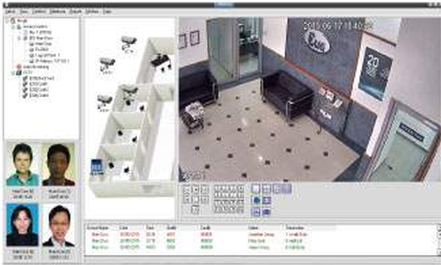
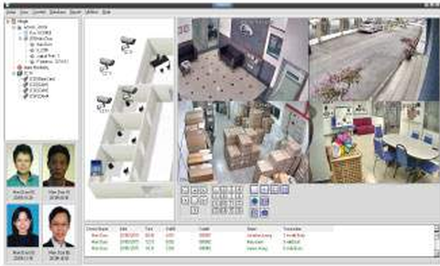
CCTV Integration
Support DVR/NVR from manufacturer:
  Hikvision, Dahua
High definition Video
Live Stream
Playback
PTZ
Event driven
  Transaction triggered.
    E.g. Door forced open alarm
  video clips
  Snapshots

Slide 27
DAHUA SETUP
Dahua CCTV Integration can work with WinPro2 version 2.1.2.18 or later. You may download and install the latest WinPro2 from Tiki Support website:
http://www.elid.com/support/tiki-index.php?page=WinPro+SQL-based+Access+Manager
Download and install Dahua Add-On Installation file into WinPro folder:
http://www.elid.com/support/tiki-download_file.php?fileId=389
Make sure DHCCTV.Exe can be found under WinPro\CCTV folder
Open both EdotPro.ini configuration settings file from the path below:
C:\Program Files (x86)\WinPro
C:\Program Files (x86)\WinPro\Server

Slide 28
Edit both EdotPro.ini as below:
[Options]
CondIOEnabled=1
Edit C:\Program Files (x86)\WinPro\Edotpro.ini:
[Designer]
Advanced=1
Setup Dahua NVR as usual and ensure that it is working fine.
Network Parameters (IP Address, Port & etc.)
Username & Password
Add IP Camera
Others
[CCTV]
Enable=1
DaHua=1
rem DVRIP=127.0.0.1

Slide 29
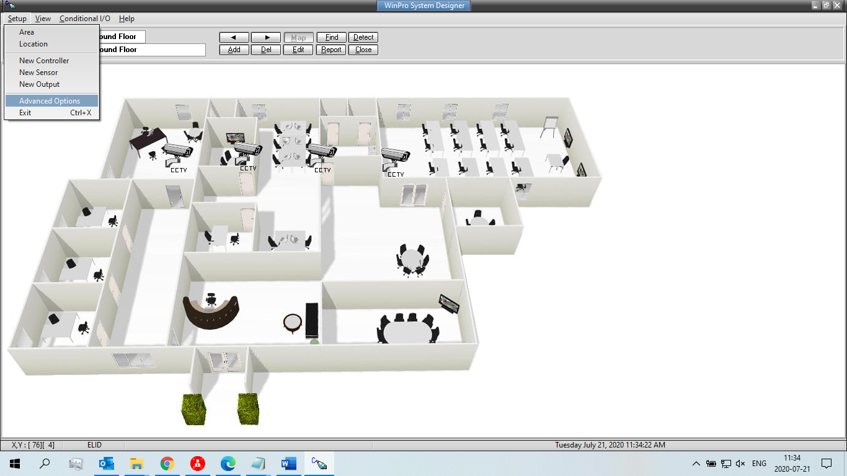
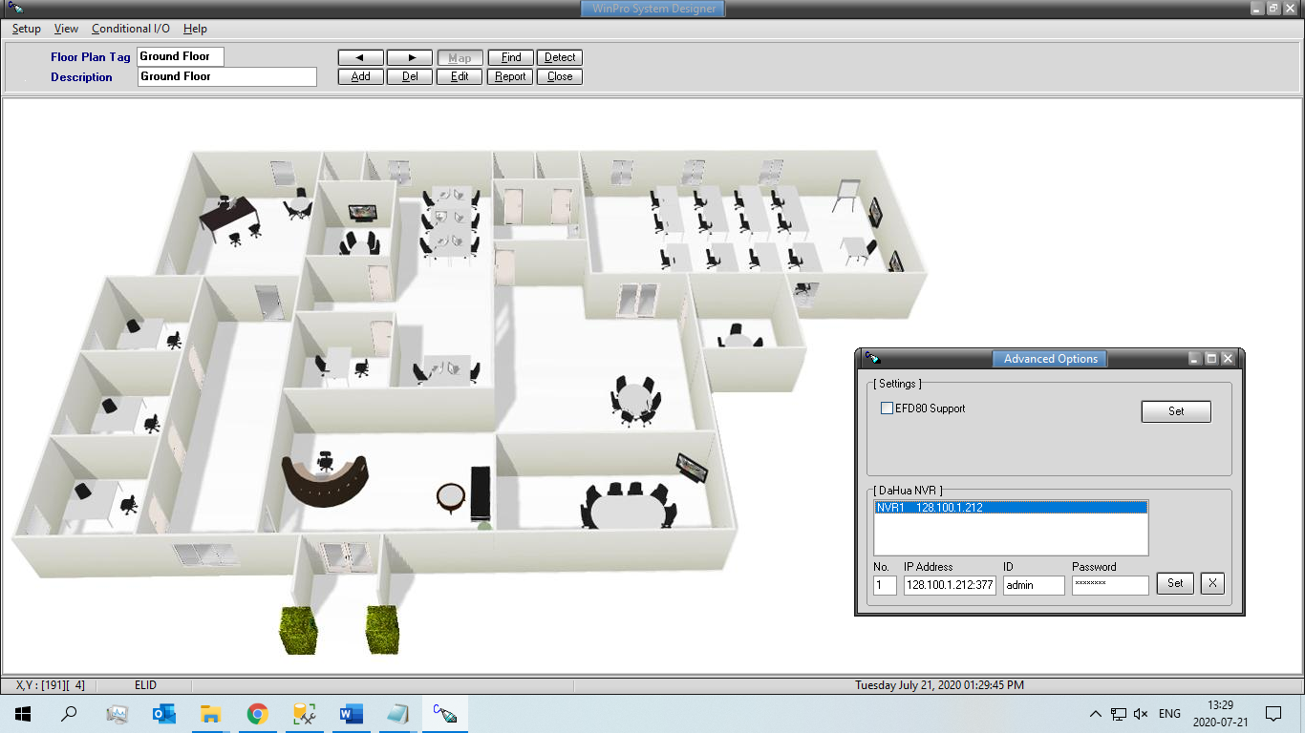
Run Designer, select Setup | Advanced Options
Enter 1, <IP Address:Port>, Username, Password, then click <Set>

Slide 30
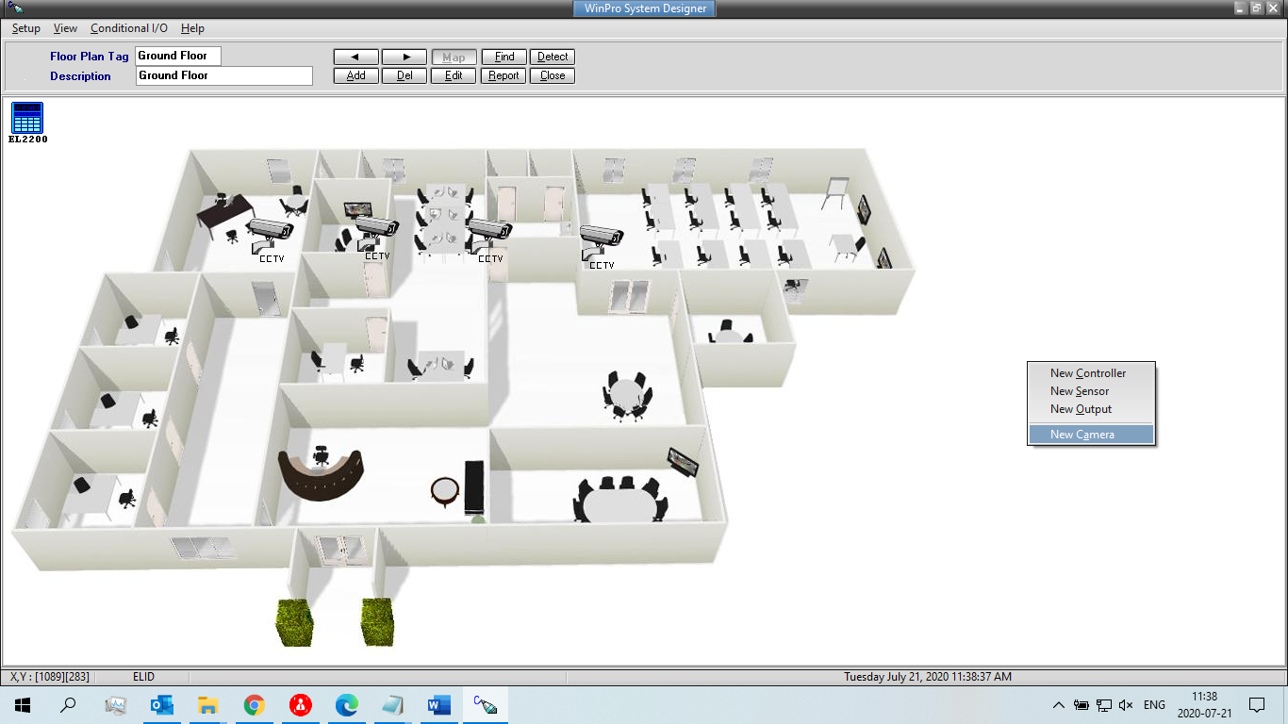
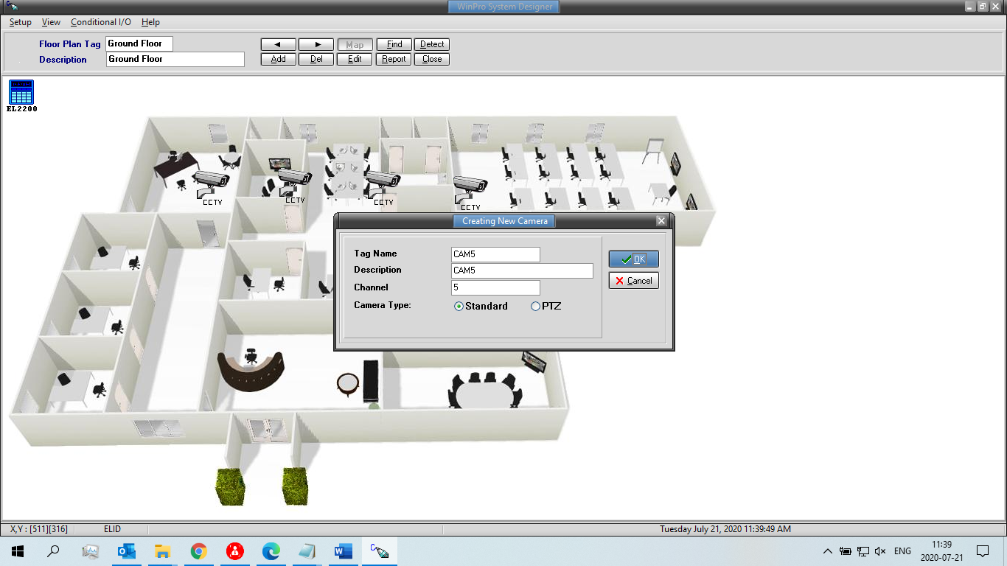
Right click mouse and select New Camera
Click [OK] to confirm camera adding

Slide 31
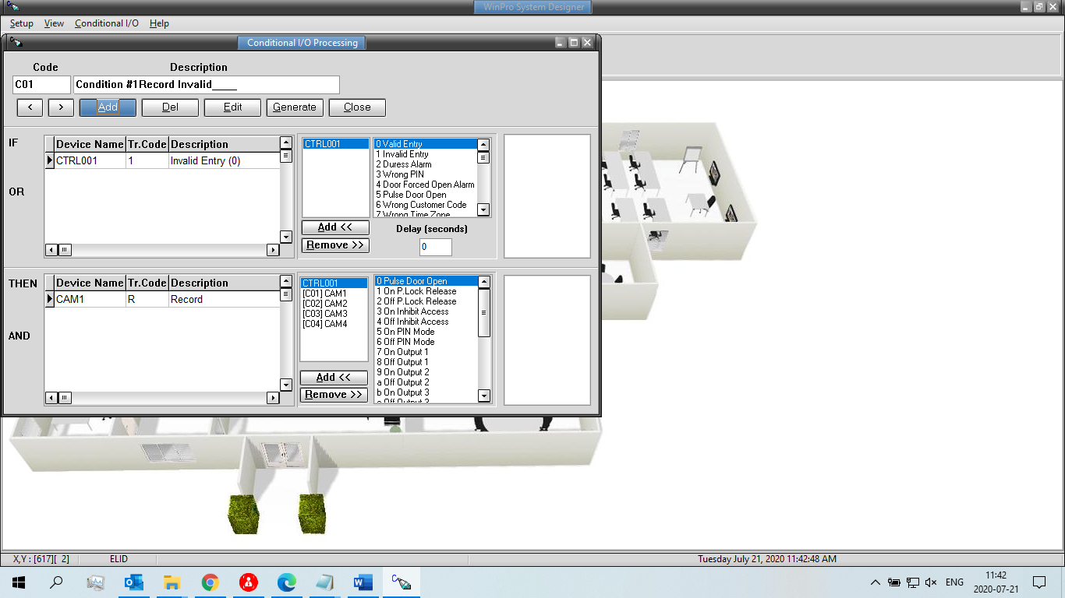
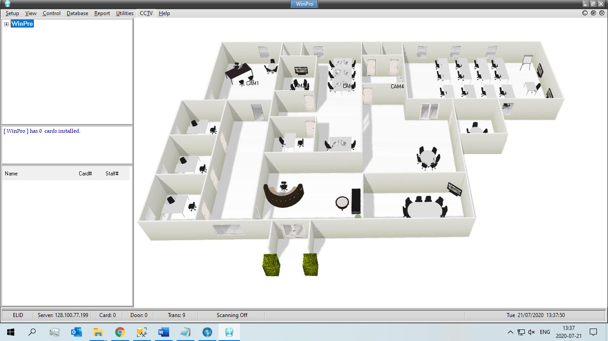
Select Conditional I/0 to setup the response of camera in certain condition.
Exit Designer, run WPSvr/WPMgr.
From pull down menu, click CCTV

Slide 32
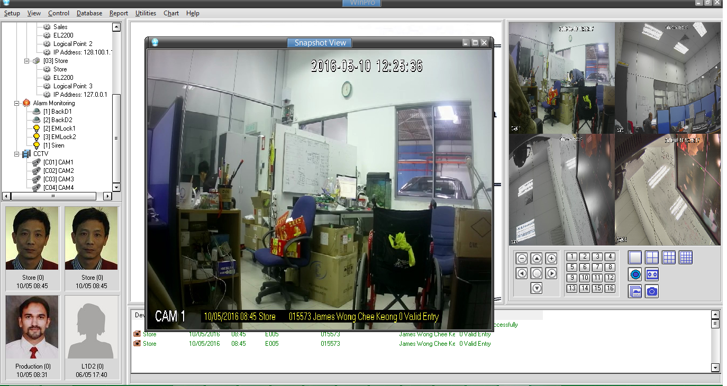
14. DHCCTV.Exe will be launched from WinPro\CCTV subfolder and live video from cameras will be displayed.
Click on the transaction with snapshot/record icon can open the picture or video recorded.
For Hikvision setup click here:
http://www.elid.com/support/tiki-download_wiki_attachment.php?attId=1764&download=y

Slide 33
CCTV DEMO

Slide 34
SUPPORT DOCUMENT
ELID WEBSITE
www.elid.com
ELID YOUTUBE CHANNEL
www.youtube.com
Search: ELID EL2306D or WinPro

Slide 35
Q & A Session

