Slide 1
DMS with Matrix & ANPR
User Manual

Slide 2
Contents
System Architecture
Connect DMS to Matrix database
Manage Users & Car Plate Numbers
Manage ANPR Devices
ANPR Records
Card Transactions

Slide 3
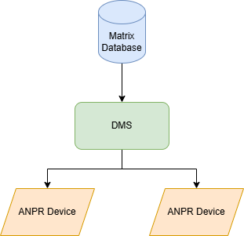
System Architecture
DMS reads existing users and cards information from the Matrix database.
Car plate numbers are added to DMS.
DMS install car plate numbers into ANPR devices.
View both card and ANPR transactions in DMS.

Slide 4
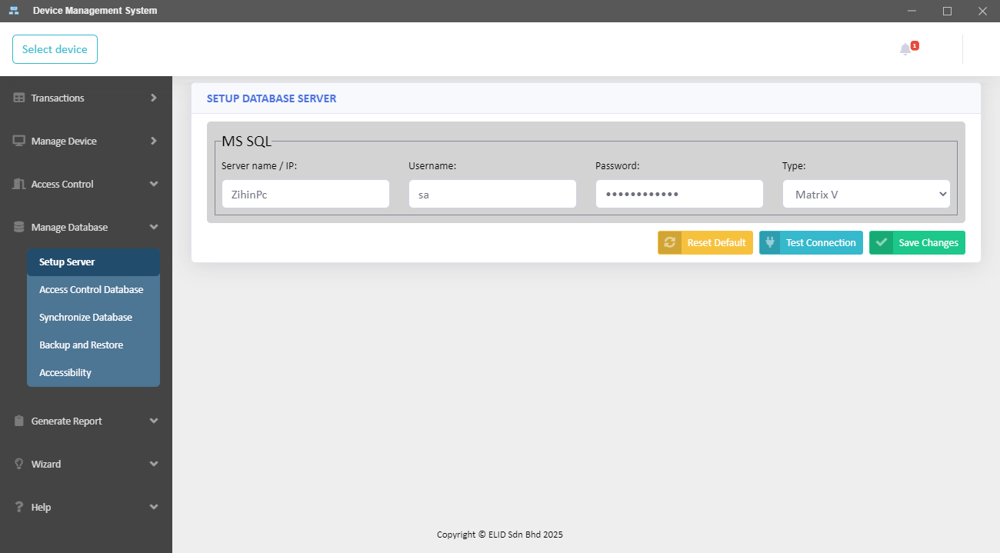
Connect DMS to Matrix database
2
1

Slide 5
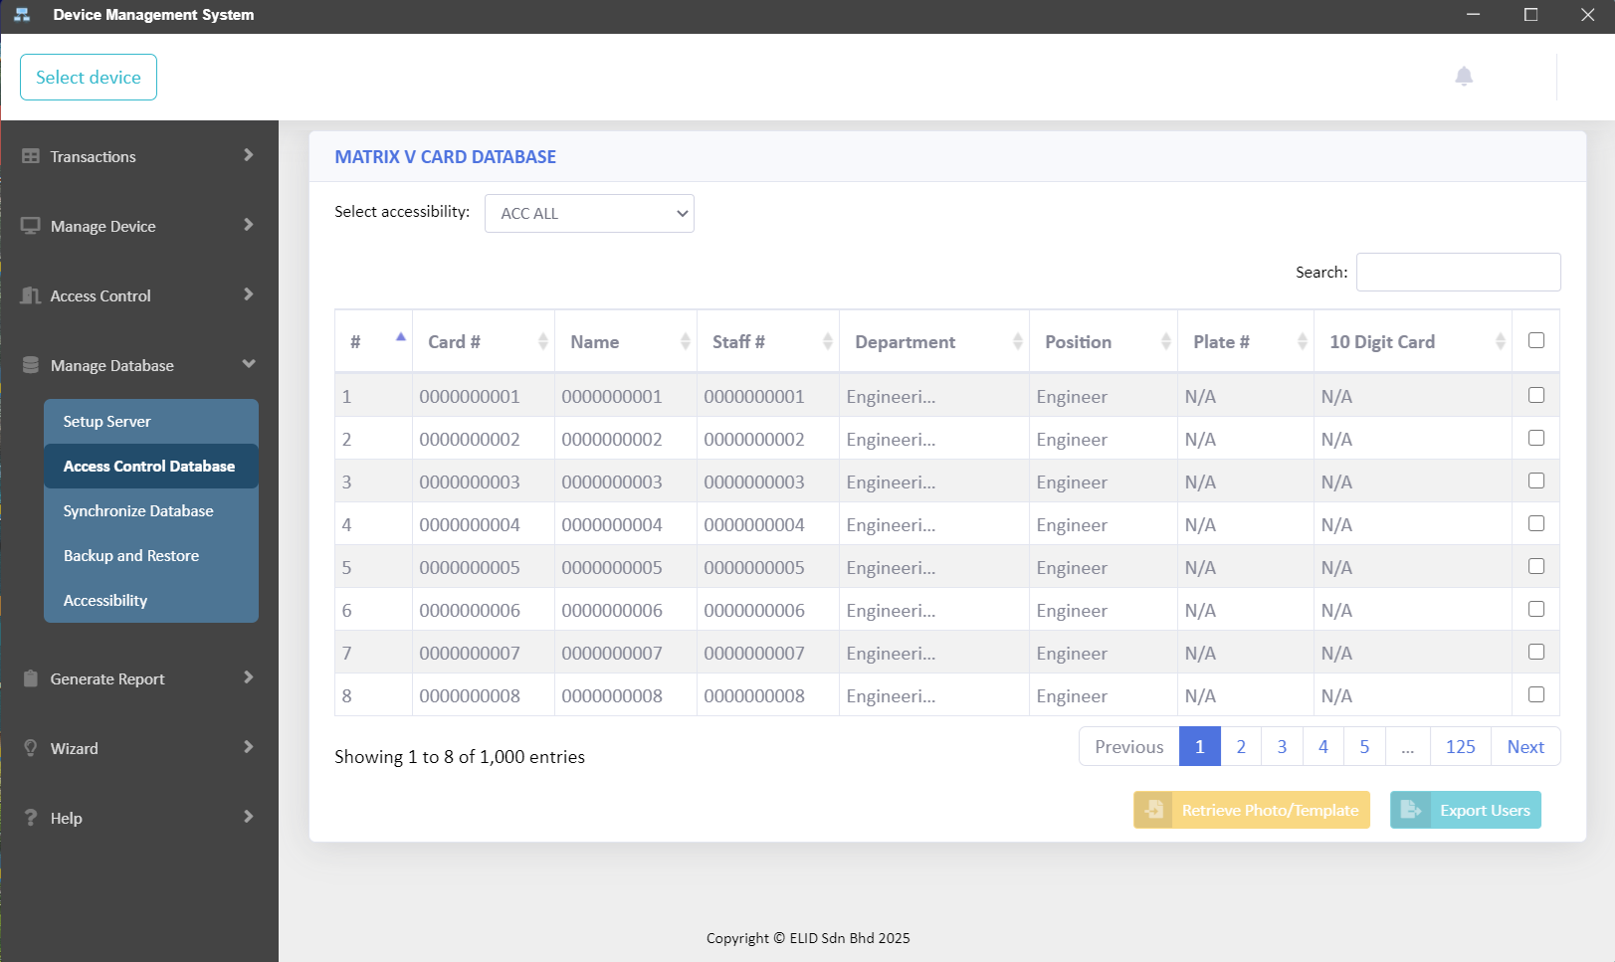
View existing users
1

Slide 6
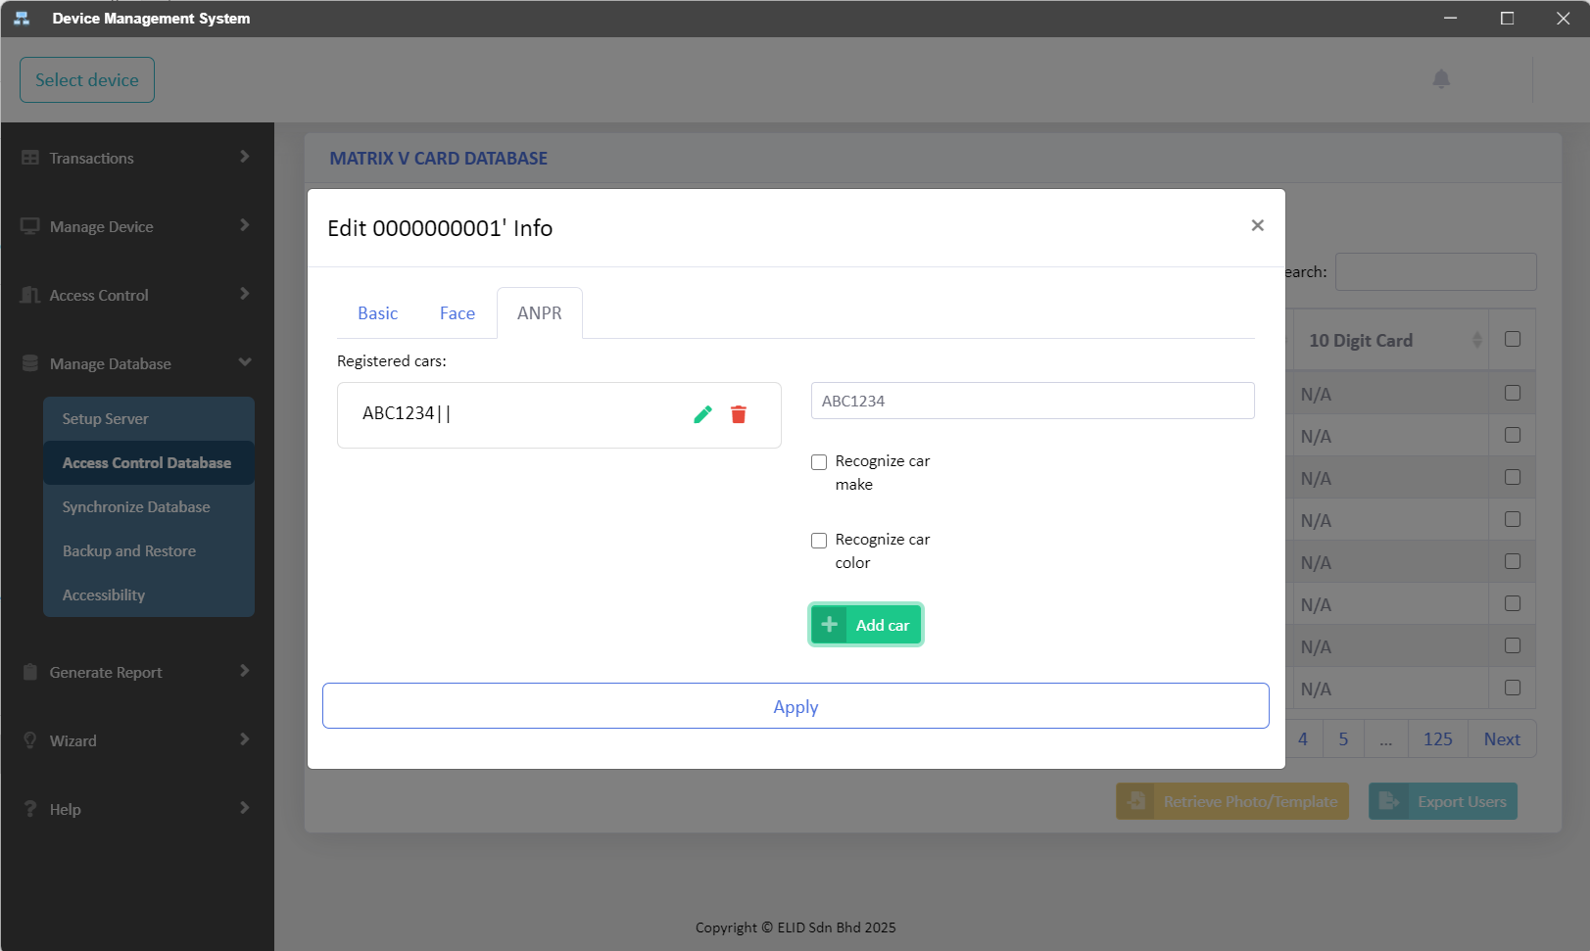
Add Car Plate Number
1
2
3

Slide 7
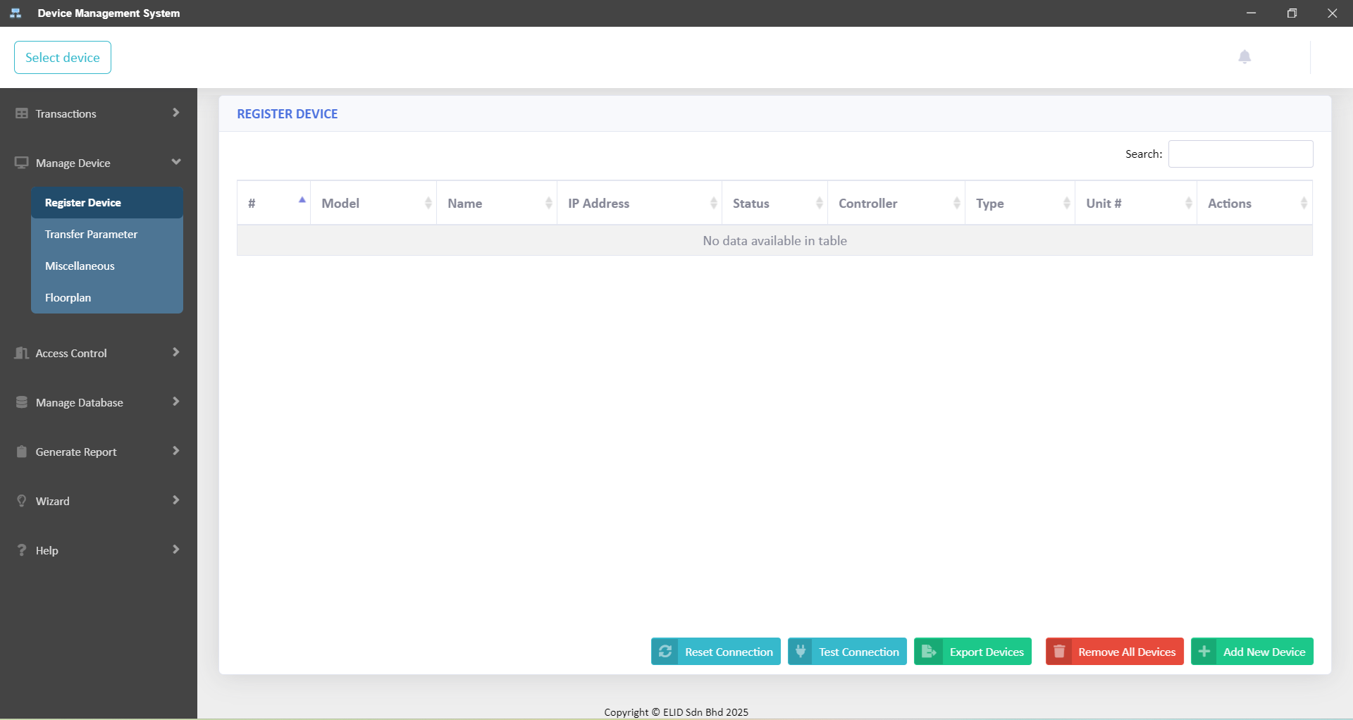

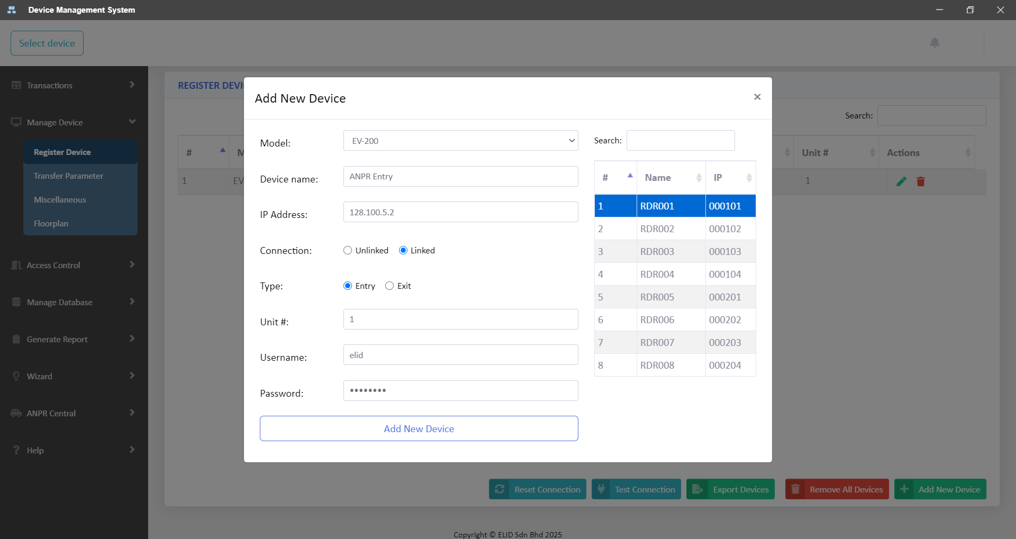
Manage ANPR Devices
1
3
2

Slide 8
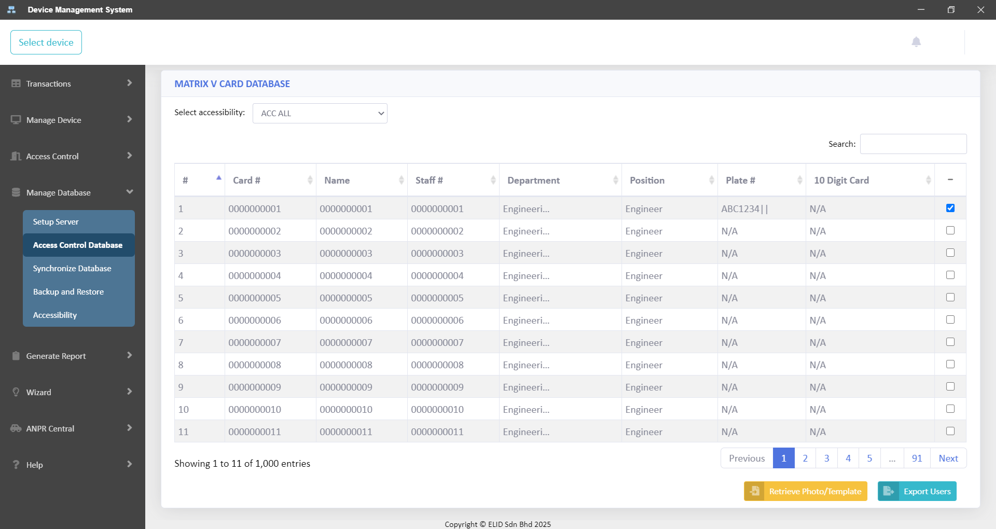
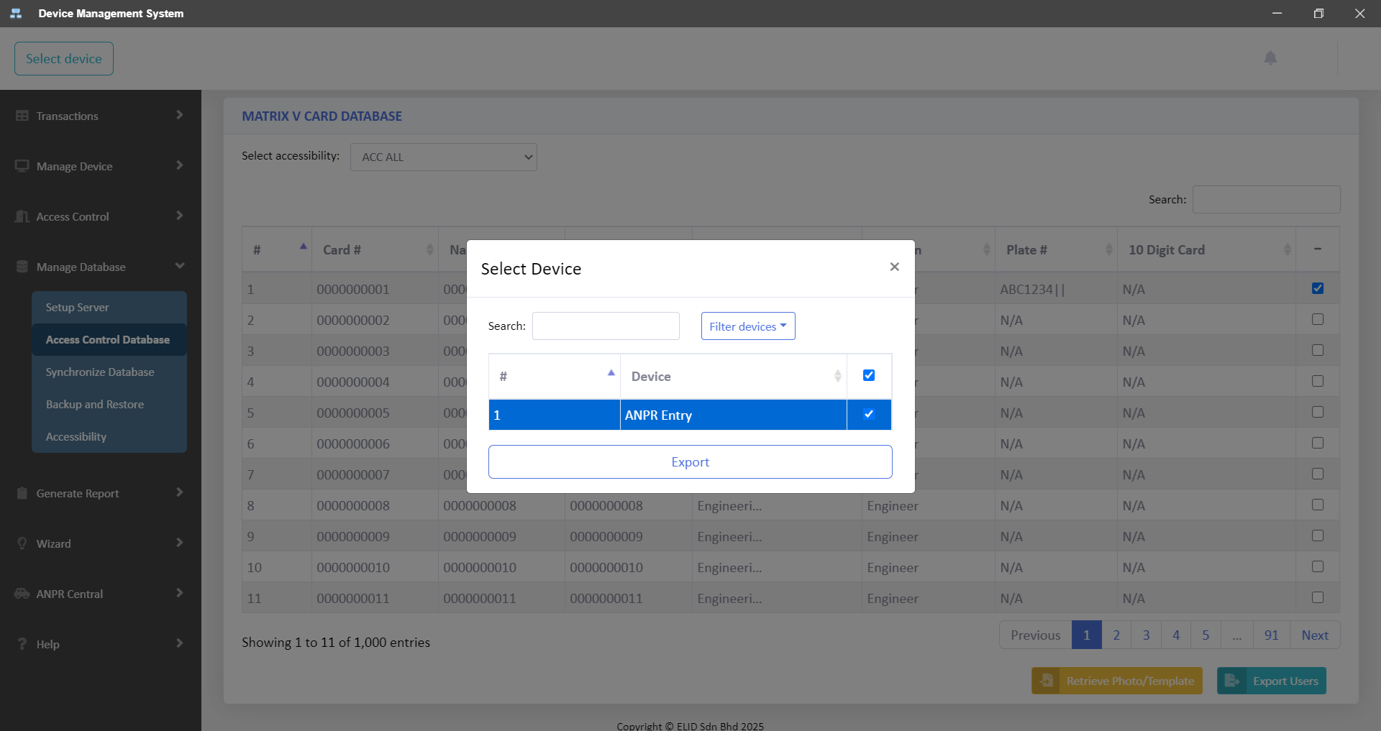
Add Car Plate Number
1
3
4
2

Slide 9
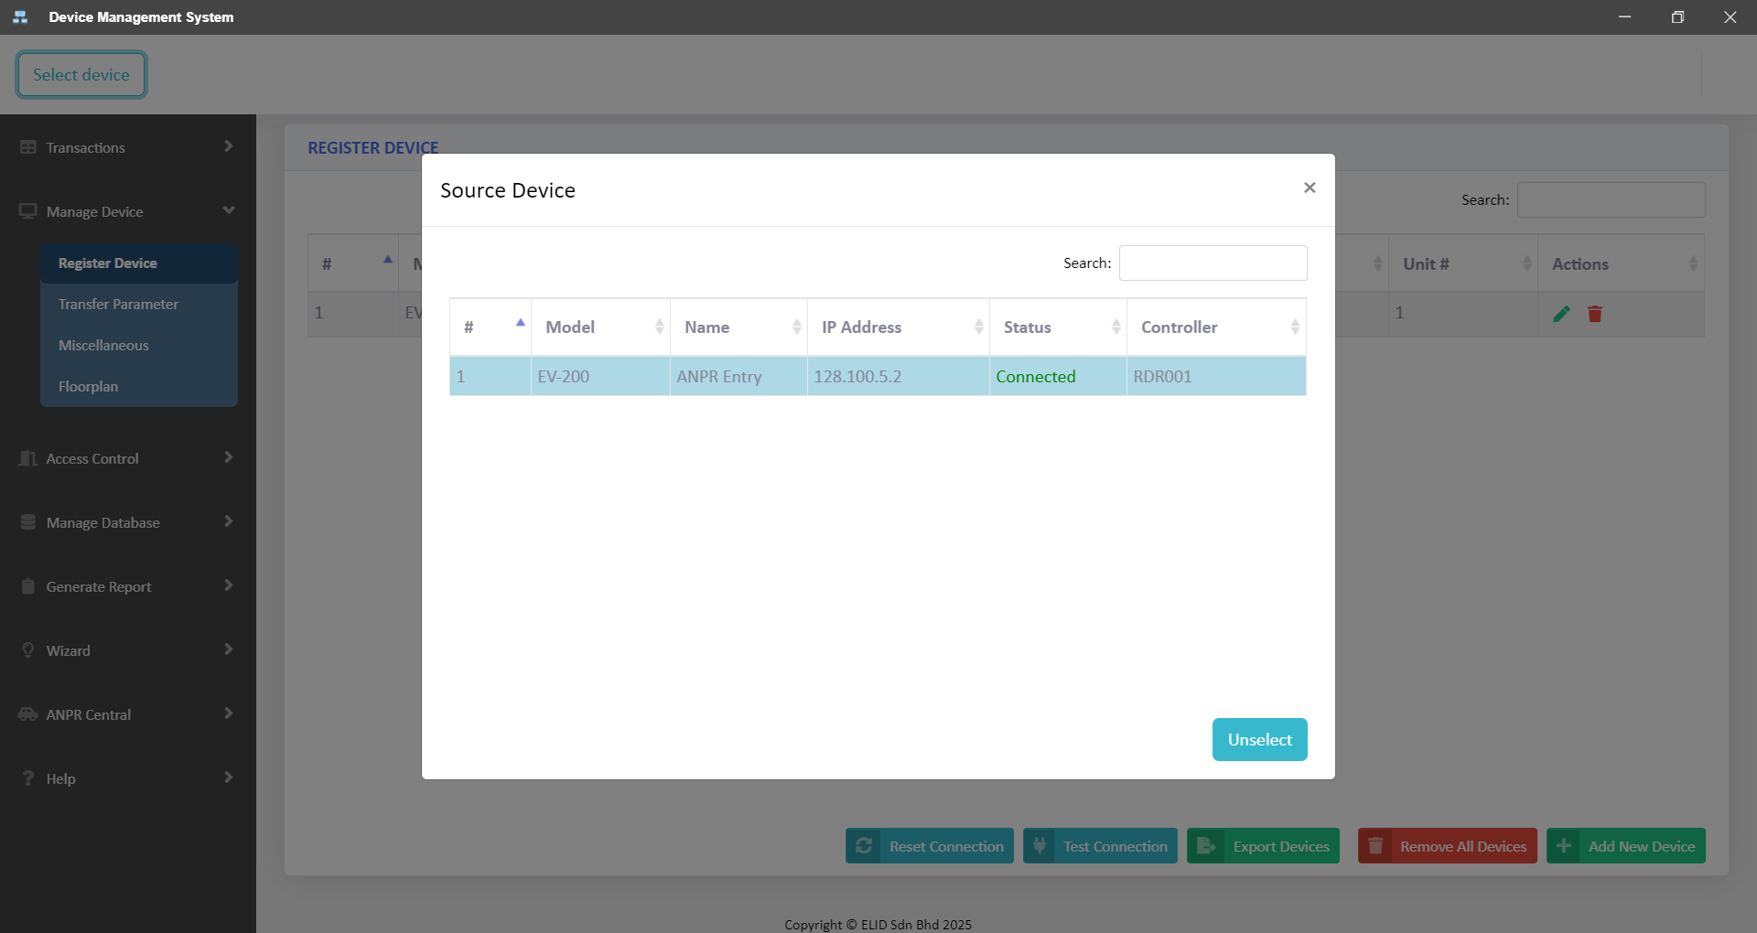
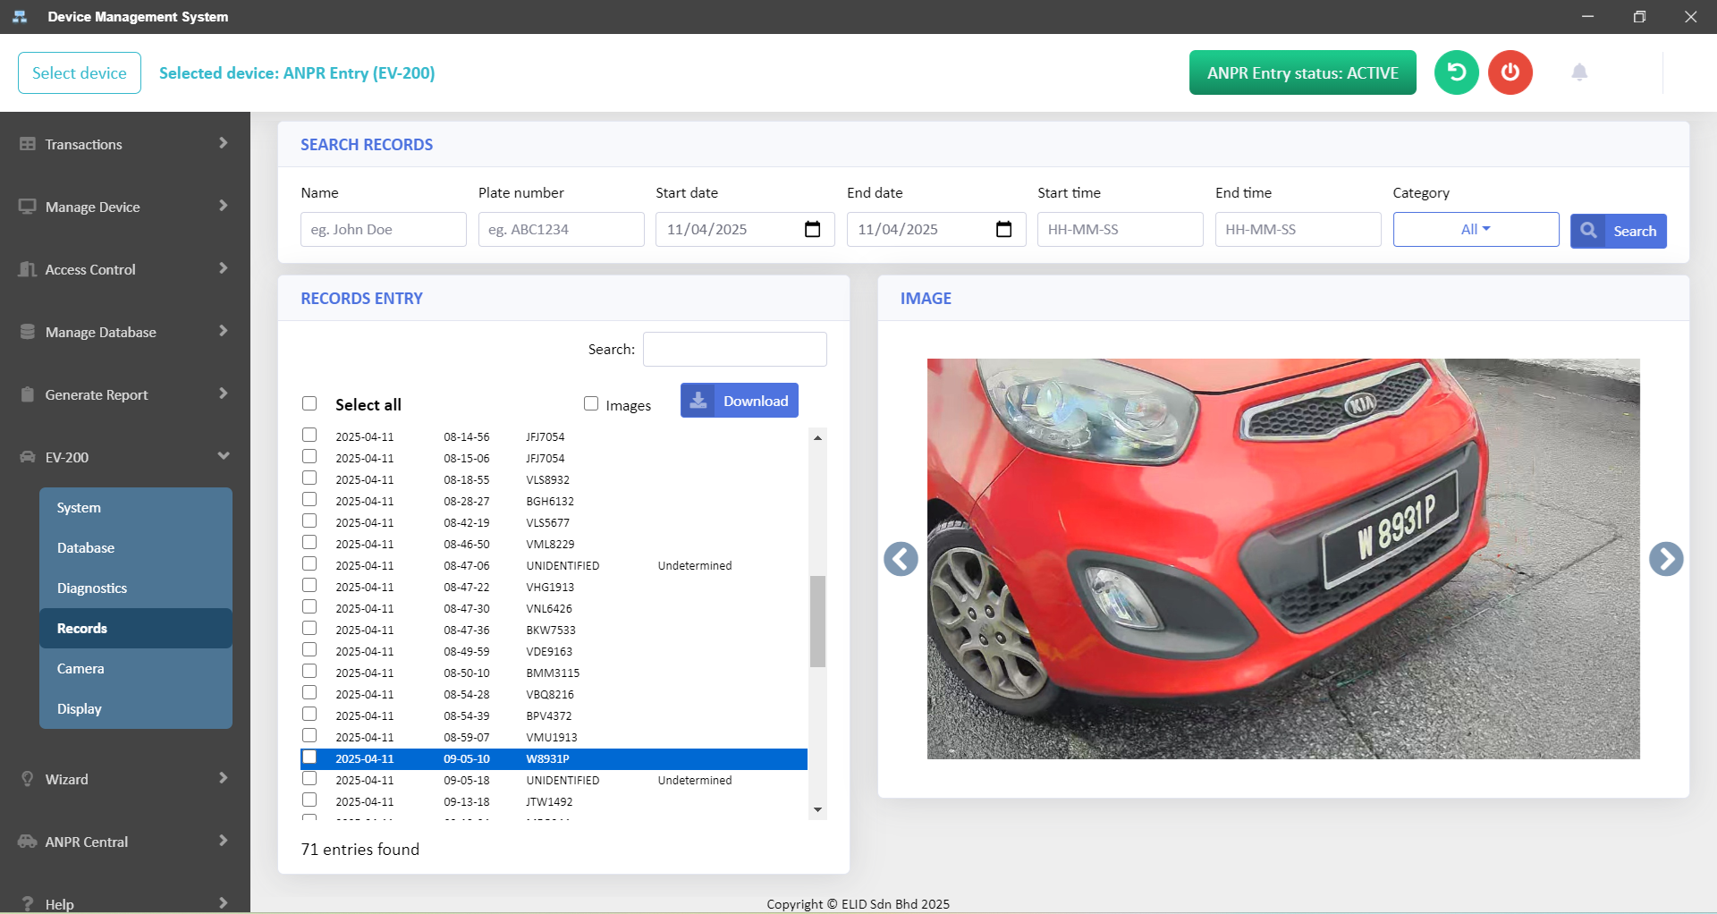
View ANPR Records from Device
1
4
2
3

Slide 10
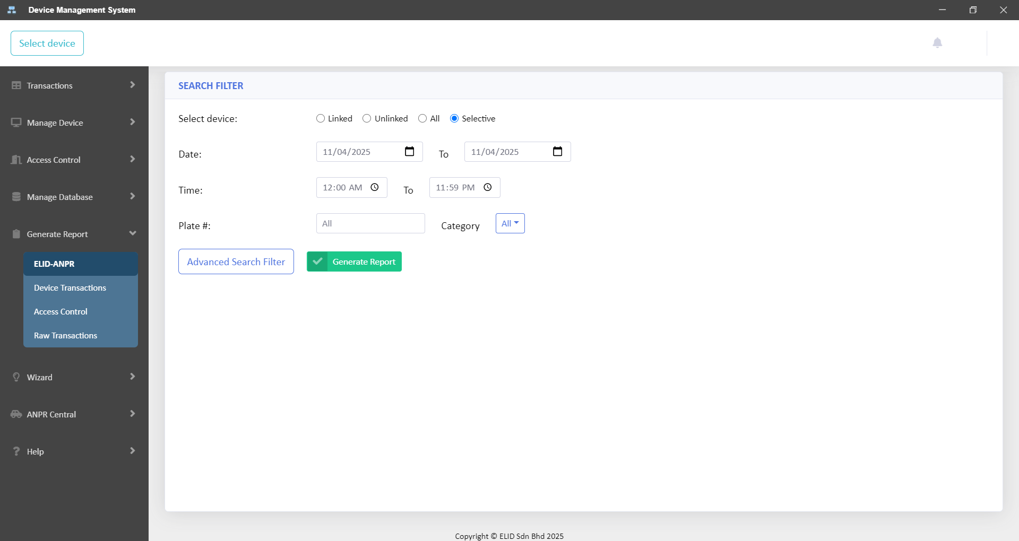
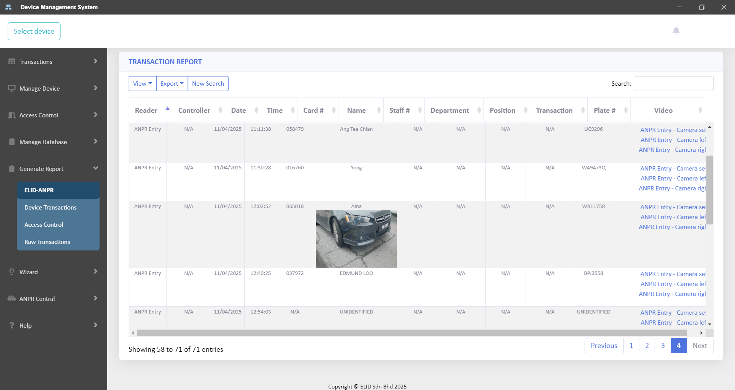
Generate ANPR Transactions
1
2

Slide 11
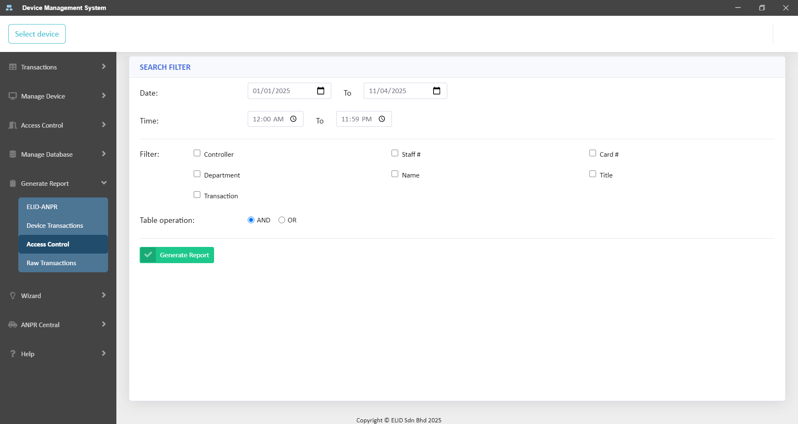
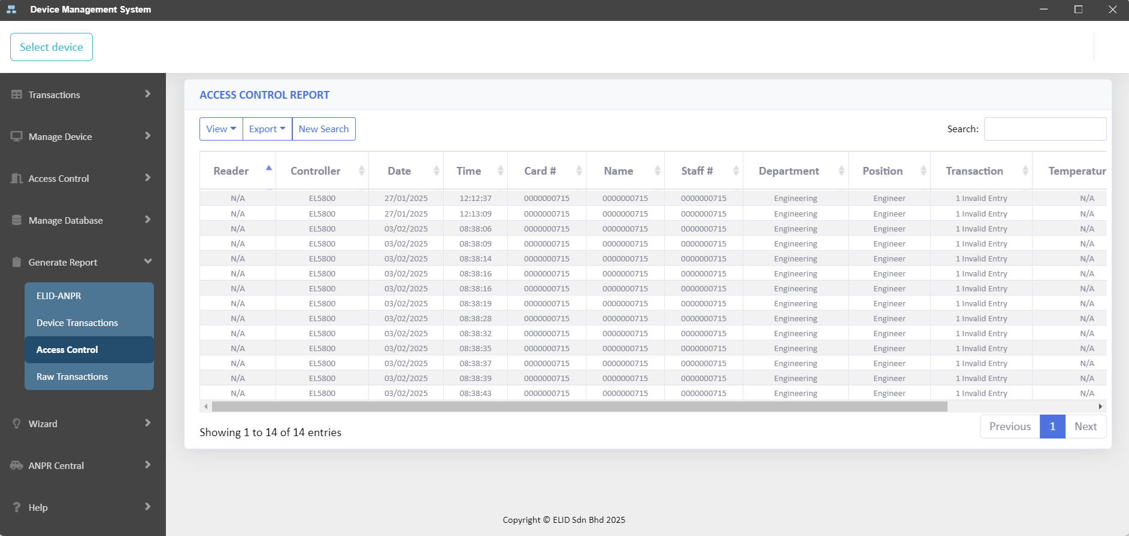
Generate Card Transactions
1
2

